Slide 1

Predictive Analytics for Business Strategy

Slide 2
By the end of this class, you should be able to:
Describe the differences between models that are endogenous and models that are exogenous.
Explain what a confounding factor is.
Explain why we don’t have confounding factors in RCTs.
Explain why we also don’t have confounding factors in models to be used for passive prediction (it’s a different reason).

Slide 3
Passive prediction
What do we need to be able to make a good passive prediction?

Slide 4
Passive prediction
What do we need to be able to make a good passive prediction?
Observational data
and ideally a random sample of the population

Slide 5
Active prediction
What do we need to be able to make a good active prediction?

Slide 6
Active prediction
What do we need to be able to make a good active prediction?
An exogenous model (& ideally a random sample)
Up to now, we have said the easiest way to ensure an exogenous model was an RCT.
But what does it mean for a model to be exogenous and why does the RCT get us that?

Slide 7
Exogenous model
A model is exogenous if none of the X variables in the model are correlated with U.
This is only a concern for models to be used in active prediction.
Can you guess why?

Slide 8
Exogenous variable
A variable X is exogenous if it is not correlated with anything in U.
So the model is exogenous if every single X variable in it is exogenous.
This is only a concern for models to be used in active prediction.

Slide 9
Endogenous variable
A variable X is endogenous if it is correlated with anything in U.
This is only a concern for models to be used in active prediction.

Slide 10
Endogenous model
A model is endogenous if any of the variables in the model are endogenous.
This is only a concern for models to be used in active prediction.

Slide 11
What about the “things” in U?
We said that a variable X is endogenous if it is correlated with anything in U.
We have a name for each thing in U that X is correlated with:
A confounding factor

Slide 12
Confounding factor
A confounding factor messes up (or confounds) our ability to estimate the causal impact of X on Y.
It has two characteristics:
It directly impacts Y (is in U)
It is correlated with X

Slide 13
Recall “variable of interest” definition
Recall that variable of interest is an X variable whose causal effect on Y we wish to estimate.
Confounding factors make it harder for us to do that.
If we are doing passive prediction, we are not concerned about any causal effect.
Hence there is no variable of interest.

Slide 14
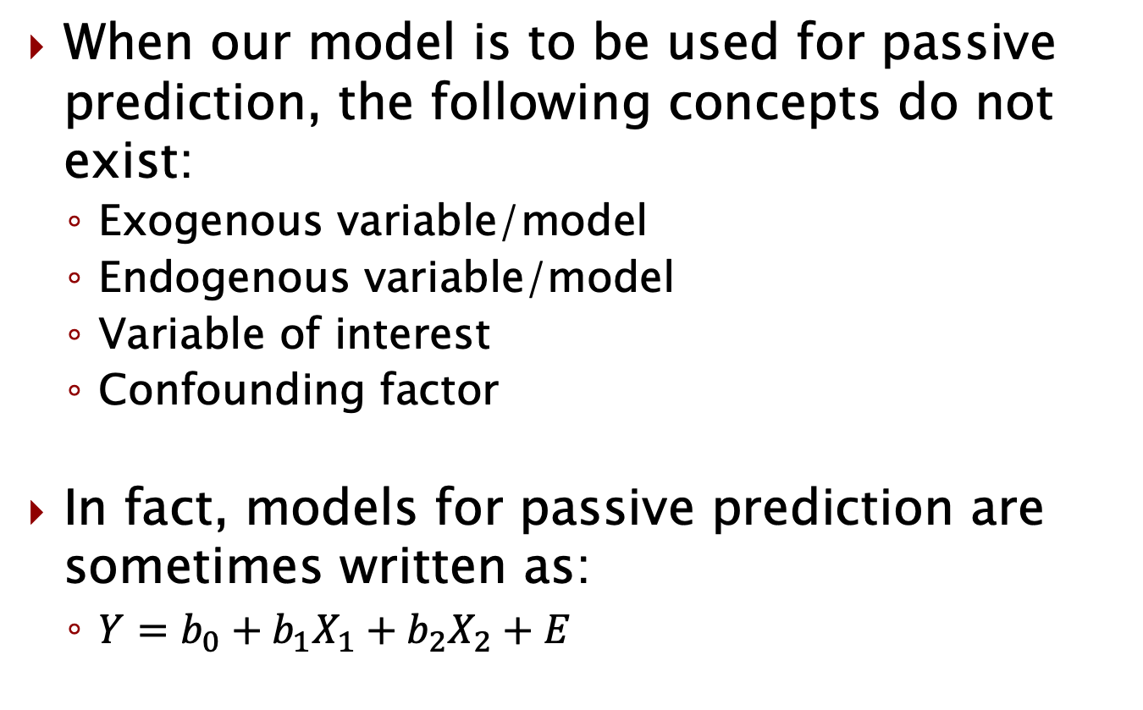
For passive prediction
When our model is to be used for passive prediction, the following concepts do not exist:
Exogenous variable/model
Endogenous variable/model
Variable of interest
Confounding factor
In fact, models for passive prediction are sometimes written as:
$Y=b_{0}+b_{1}X_{1}+b_{2}X_{2}+E$

Slide 15
For active prediction
When we want to engage in active prediction, we always have to worry about confounding factors that lurk in U.
Does that mean that everything in U is a confounding factor?

Slide 16
Is all of U a problem?
Is everything in U a confounding factor?
Let’s review what it means to be in U and determine whether everything in U is a problem for us (a confounding factor) when we want to estimate a causal effect.
What does it mean to be in U?
For experimental data on severe case of Covid (Y) and fully vaccinated (X), what is in U?

Slide 17
Is all of U a problem?
What does it mean to be in U?
Anything that directly impacts Y and is not an X in our model (is not observed).
For experimental data on severe case of Covid (Y) and fully vaccinated (X), what is in U?
Age
Type of job
History of health problems
Etc.

Slide 18
Estimating the effect of vaccines
For experimental data on severe case of Covid (Y) and fully vaccinated (X), what is in U?
Age
Type of job
History of health problems
These (& others) are all in U.
Are they confounding factors?
What’s the other criterion to be a confounding factor?

Slide 19
Confounding factors
A confounding factor is:
In U
Correlated with X
It messes up (confounds) our ability to estimate the causal effect of X on Y.
Because when we regress Y on X, some of its effects are picked up by the coefficient on X.

Slide 20
Do these factors cause a problem?
We said things like age, type of job, and history of health problems are all in U when regressing severe Covid on vaccine.
In an RCT, are they confounding factors?
Would your answer be different if this was observational data and we wanted to estimate the causal impact? If yes, how?

Slide 21

We bought a horse…

Slide 22
Horse owners live longer
The article doesn’t necessarily imply causality… but that doesn’t mean the reader won’t imagine a causal relationship
Perhaps if you buy a horse it will make you more active and more relaxed and extend your life
This isn’t a crazy theory…
But it’s also not a good estimate of the causal effect of owning a horse on life span.
Why isn’t it a good estimate of the causal relationship?

Slide 23
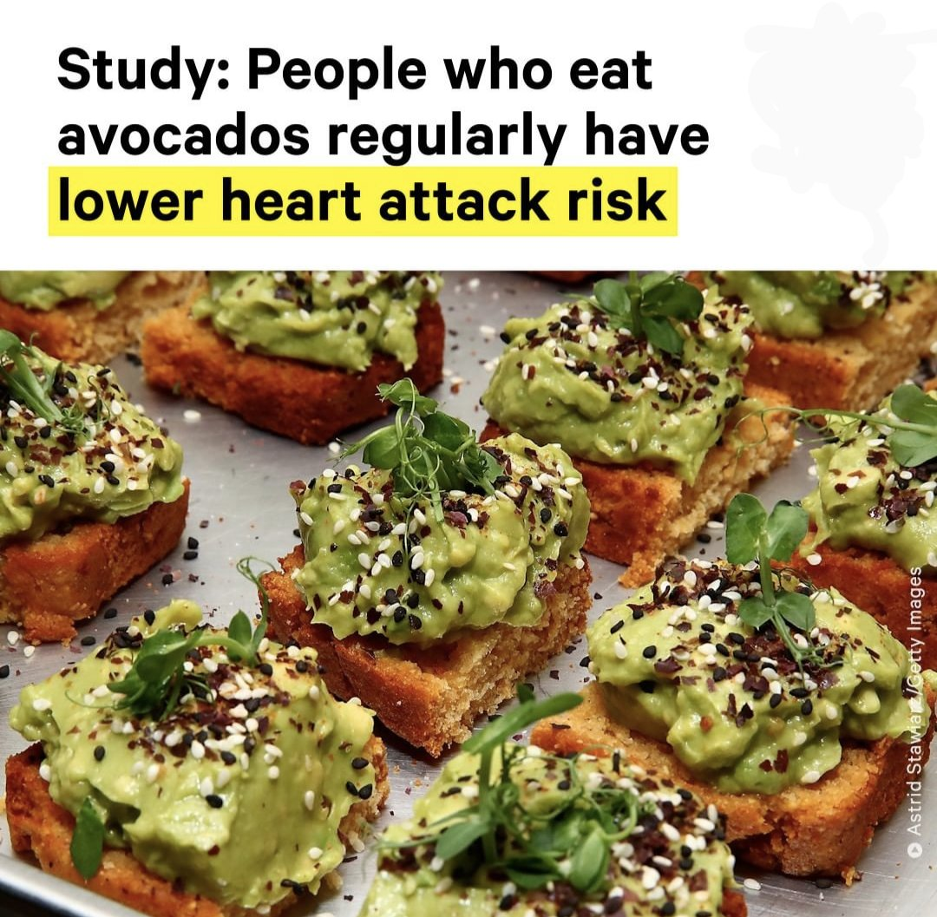
What’s (likely) wrong in this implication?

Slide 24
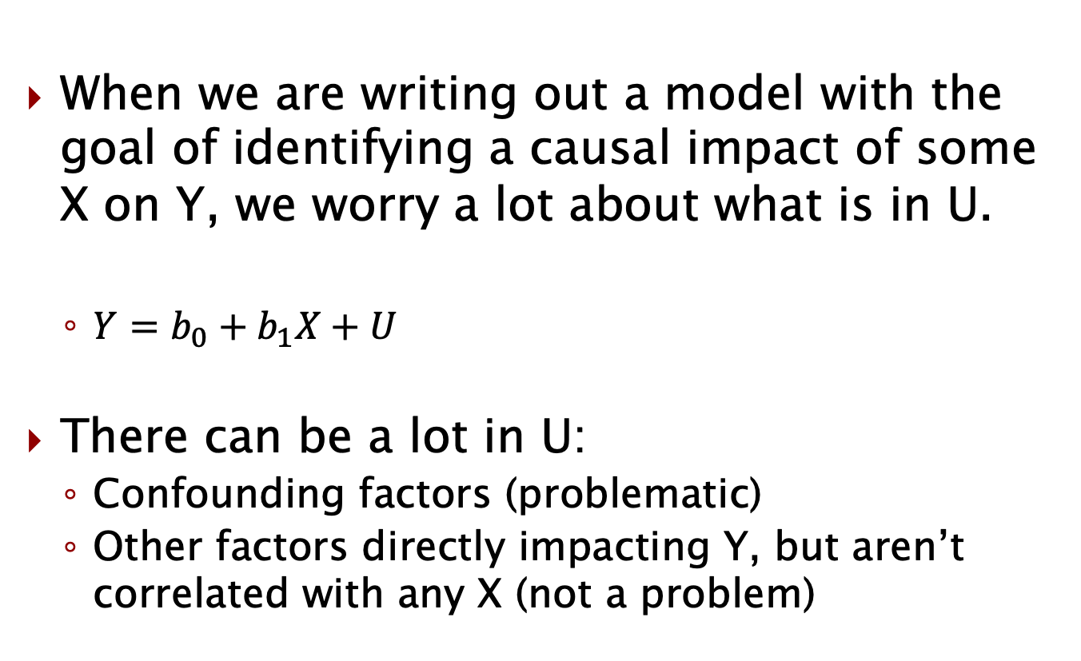
What’s in U?
When we are writing out a model with the goal of identifying a causal impact of some X on Y, we worry a lot about what is in U.
$Y=b_{0}+b_{1}X+U$
There can be a lot in U:
Confounding factors (problematic)
Other factors directly impacting Y, but aren’t correlated with any X (not a problem)

Slide 25
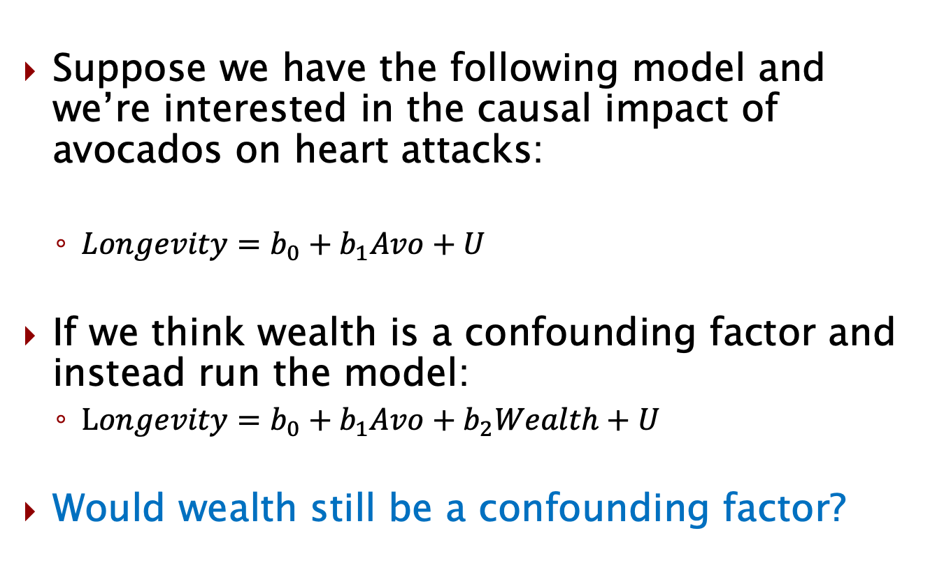
What if we have data on it?
Suppose we have the following model and we’re interested in the causal impact of avocados on heart attacks:
$Longevity=b_{0}+b_{1}Avo+U$
If we think wealth is a confounding factor and instead run the model:
$Longevity=b_{0}+b_{1}Avo+b_{2}Wealth+U$
Would wealth still be a confounding factor?

Slide 26
Confounding factors
Would wealth still be a confounding factor?
Let’s review:
A confounding factor is:
In U
Correlated with X
We’ll discuss this more later, but the correlated with X part isn’t a problem in our causal estimate since Stata essentially estimates how each X moves with Y, holding all other X variables in the model constant.
Other confounding factors may still be a problem though.

Slide 27
Classifying variables
Let’s practice classifying variables a bit:
For each of the following cases, label each variable one of the following:
Exogenous variable
Endogenous variable
Variable of interest
Outcome variable
Confounding factor
None
Also state whether you think the model is endogenous or exogenous.

Slide 28
Effect of regional Ad budget on sales
Regional population
Ad budget
Sales
Price of Advertisement (in region)

Slide 29
*Effect of regional Ad budget on sales
This is almost certainly observational data.
Regional population
Confounding factor if not observed (in U)
Ad budget
Variable of interest X, endogenous
Sales
Outcome variable Y
Price of Advertisement (in region)
None
The model is endogenous

Slide 30
Effect of price of tomatoes quantity sold
Price of fertilizer used to grow tomatoes
Price of tomatoes
Quantity sold
Quality of tomatoes

Slide 31
*Effect of price of tomatoes quantity sold
This is almost certainly observational data.
Price of fertilizer used to grow tomatoes
None
While this would impact the price and the price impacts quantity sold, if consumers are not considering this when buying, it does not directly impact quantity sold.
Price of tomatoes
Variable of interest X, endogenous
Quantity sold
Outcome variable Y
Quality of tomatoes
Confounding factor if not observed (in U)
The model is endogenous

Slide 32
Effect of image size on click rate A/B test
Tenure (how long a customer)
Daily usage (hrs)
Click-through rate
Image size
Customer annual income

Slide 33
*Effect of image size on click rate A/B test
RCT, so we would likely just regress click rate (Y) on image size (X).
The model is exogenous, Assuming proper A/B test
Tenure (how long a customer)
None (RCT, so not an X, not correlated with X)
Daily usage (hrs)
None (RCT, so not an X, not correlated with X)
Click-through rate
Outcome variable Y
Image size
Variable of interest X, exogenous
Customer annual income
None (RCT, so not an X, not correlated with X)

Slide 34
Wrap up
A variable X is exogenous if it is not correlated with any confounding factors.
C.F. must be in U, correlated with X.
A variable X is endogenous if it is correlated with any confounding factor.
A model is exogenous if it has no endogenous variables.
Otherwise endogenous.
RCTs have no confounding factors since nothing correlated with treatment.
No confounding factors in models for passive prediction since nothing for them to confound (no variable of interest).

Slide 35
Announcements/Reminders
Problem Set 2 due Sunday 2/5.

